Slide 1

Mapping of Civil Society Organizations in the Mediterranean Analysis of results and implications for the PeaceMed network
Project Name: PeaceMed
Date: 25 March 2026

Slide 2
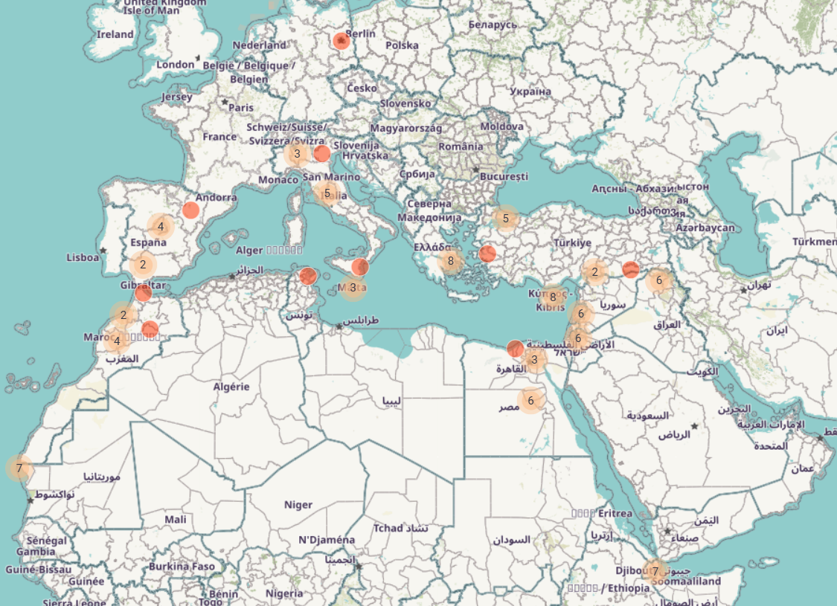
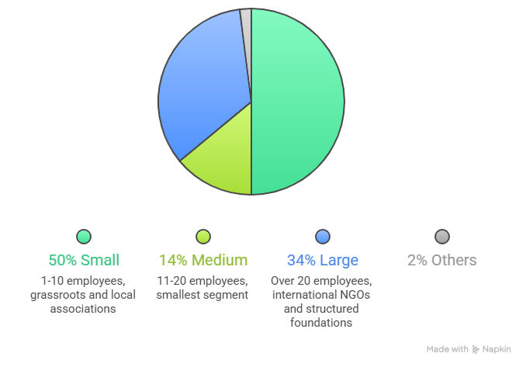
The Landscape of Mapped CSOs at 24° March 2026
Key Numbers: 100 CSO mapped from MENA, Europe and Horn Africa from 21 different countries
Longevity: Young and dynamic organizations (average founding: 2000s-2019).
Volunteerism: more than half of the organizations (53%) rely on 1 to 20 volunteers, 26.5% between 21 to 50 volunteers, while nearly one in five (19.3%) count on more than 50 volunteers

Slide 3
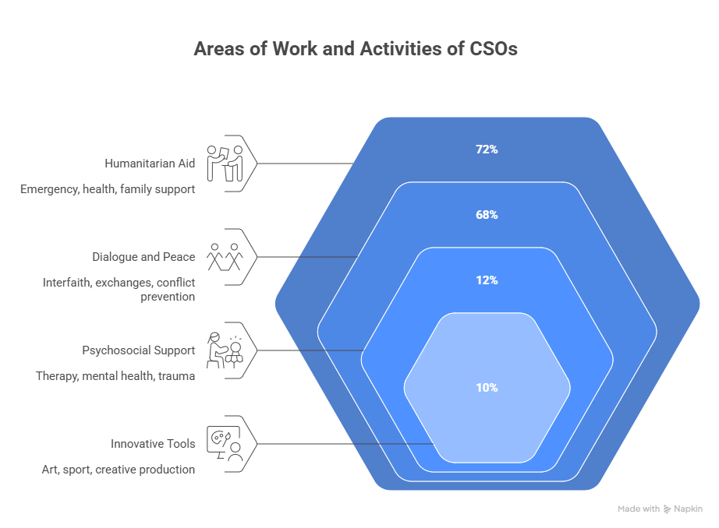

Slide 4
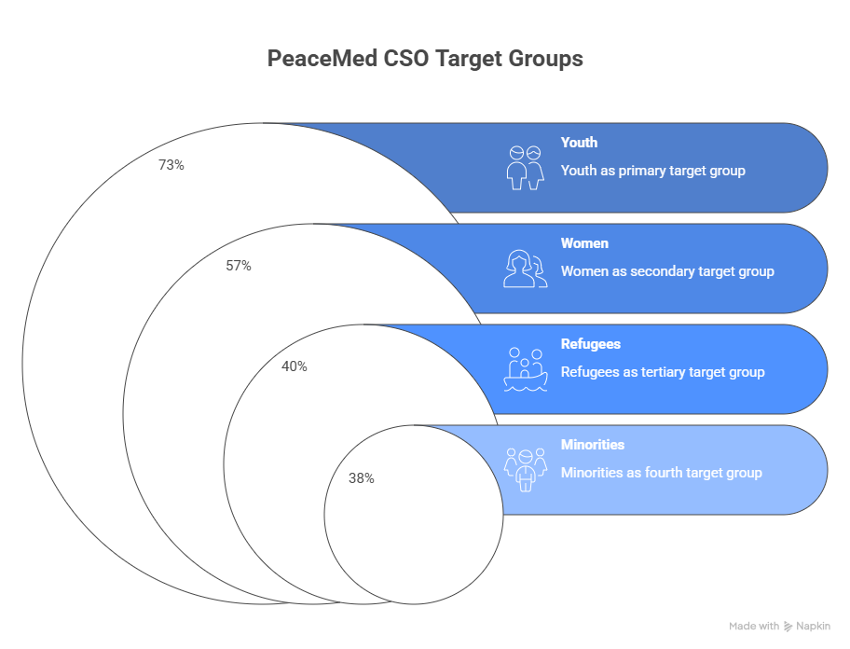

Slide 5
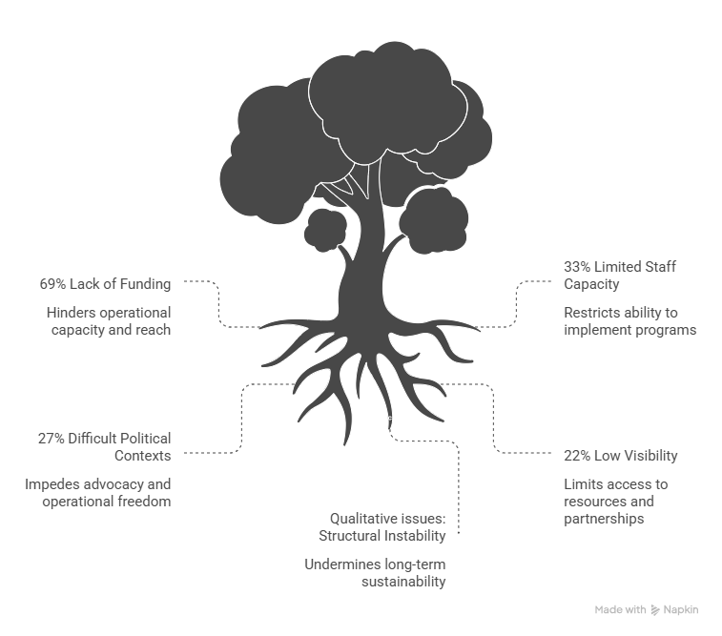
Challenges:

Slide 6
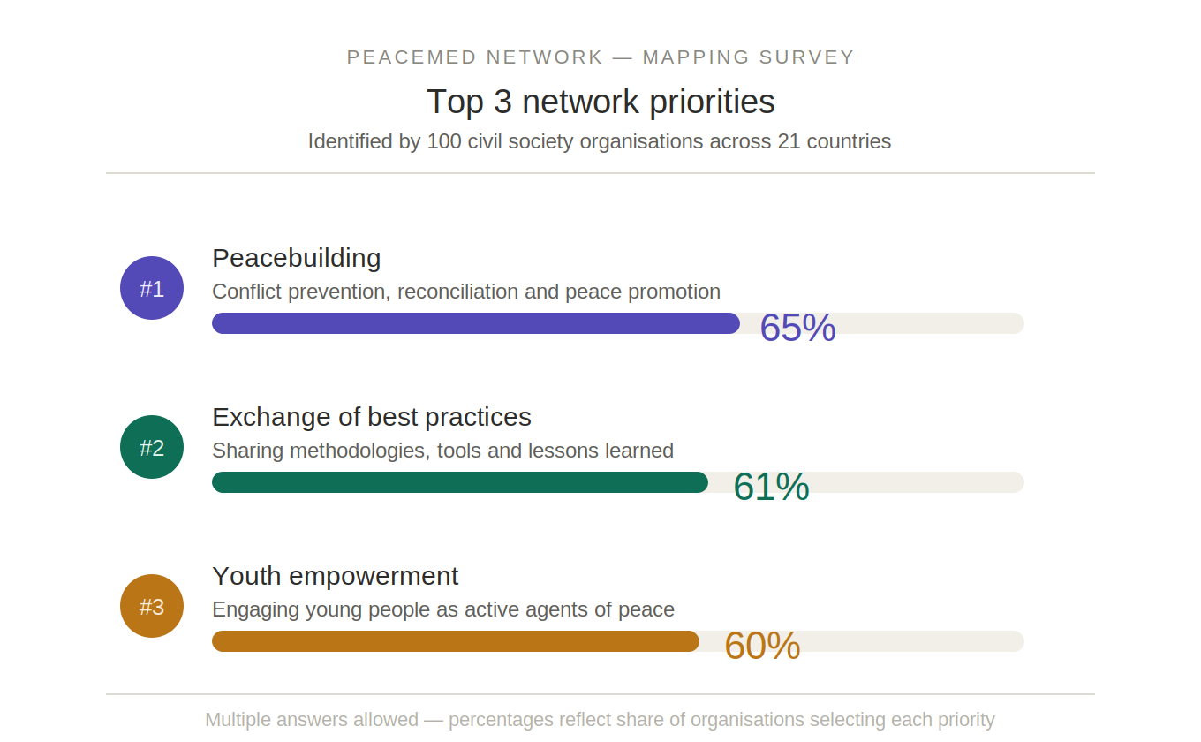

Slide 7
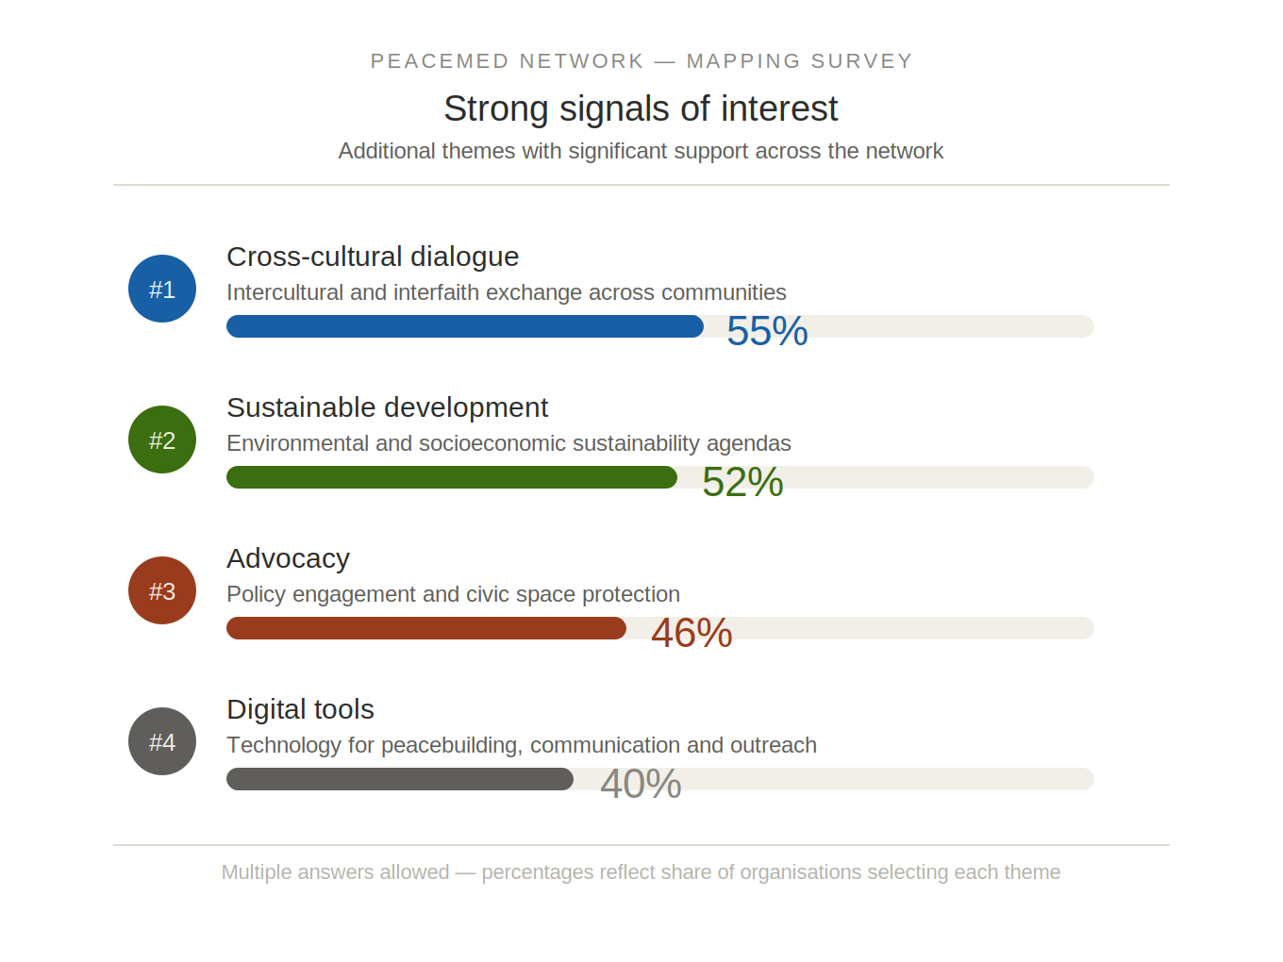
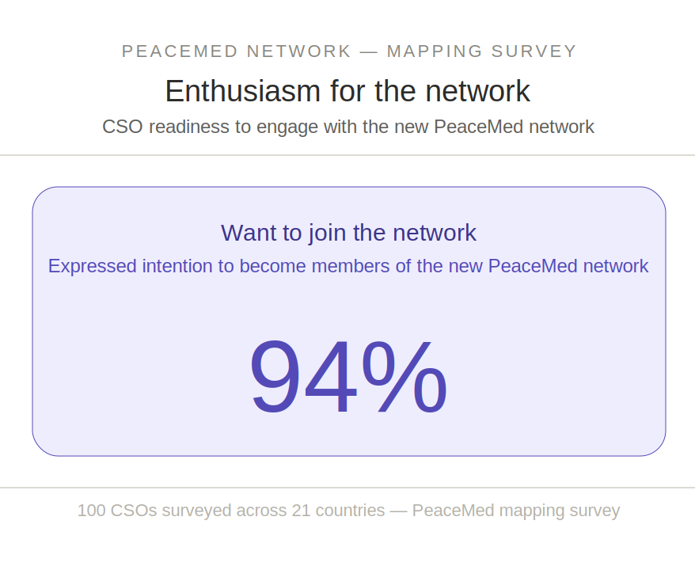

Slide 8
