Slide 1
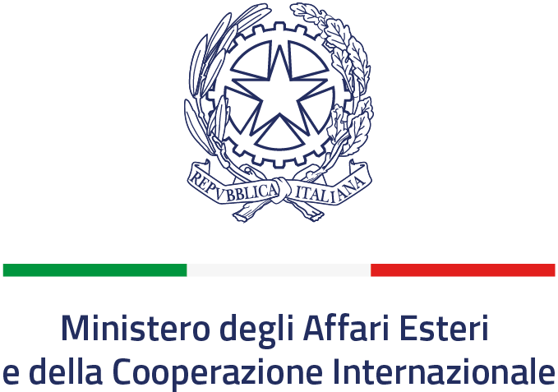
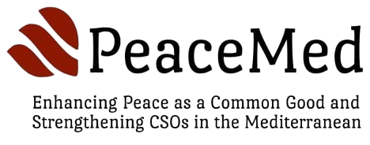
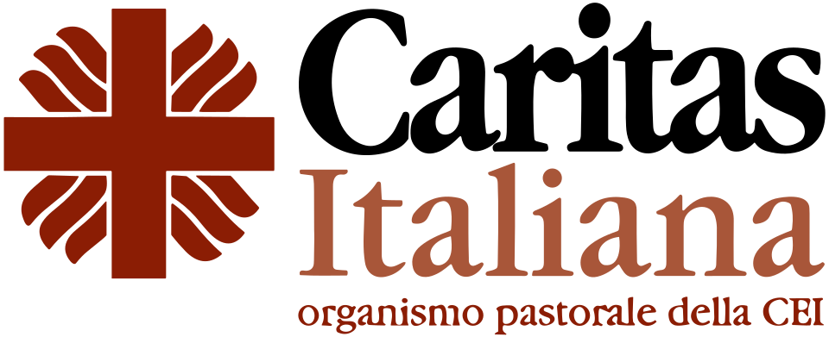
PROJECT RESULTS & IMPACT
PeaceMed
Building Peace as a Common Good
and strengthening CSOs in the Mediterranean

Slide 2
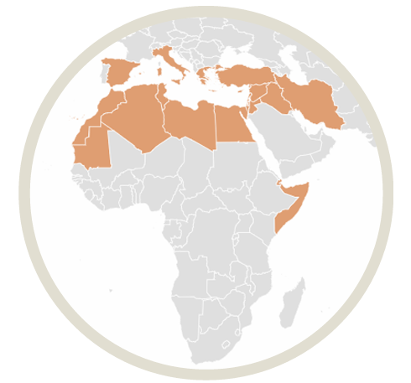
PROJECT AT A GLANCE
19
31
32
Countries
CSOs
Participants

Slide 3

STRATEGIC IMPACT
🤝
🌍
Reviving the
Peace Agenda
Resisting the
Culture of War
Peace as
Common Good
Brought peacebuilding back to the centre of civil society work in the Mediterranean at a critical moment, affirming that the need for peace is urgent.
In conflict-affected regions, PeaceMed stood as a principled counter-model, asserting that civil society can be a transformative force rooted in dialogue, participation and cooperation.
Established a unifying framework, peace as a shared resource we build collectively, transcending geopolitical divides and ideological divisions.

Slide 4
NETWORK & CAPACITY BUILDING
Bridges Across the Mediterranean
MAPPING
The project brought together very different countries. This diversity enabled the exchange of approaches, a deeper understanding of different regional dynamics, and the discovery that the challenges of peacebuilding share common roots even across geographically distant contexts.
100 Civil Society Organizations across 21 countries, with activities spanning over 50 countries globally.
Empowering Youth as Agents of Change
94% of mapped organisations expressed interest in joining the network
Young people positioned as active builders of peace, not passive beneficiaries.
From 'I' to 'We': Authentic Relationships
LETTER OF INTENT
Meetings in Cyprus, Italy and Istanbul built genuine human connections, breaking isolation and creating a resilient network grounded in shared values, not just project cycles.
16 CSOs signed the Letter of Intent
Leadership Pipeline and Local Impact
Participants became leaders in proposing and implementing initiatives in their context.

Slide 5
IDENTITY & METHODOLOGY
Shifting Focus: Emergency → Education
Going Further: PeaceMed Manual and Toolkit
Many local CSOs had drifted toward pure emergency response. PeaceMed reminded that non-formal education and capacity building are equally essential, rebalancing relief with long-term social transformation. The project transmitted Caritas Italiana's pedagogical approach: 'charity in forms suited to the times' integrating justice, peace, and integral human development.
Available in 4 languages (IT, EN, FR, AR) at project launch. By the Istanbul meeting, participants spontaneously volunteered to translate it into Turkish and Spanish, a sign of ownership and commitment to local dissemination.
CASCADE TRAINING
From participants → to trainers

